Slide 1
Employee Data Analysis using Excel
STUDENT NAME: Kavya .B
REGISTER NO: 312209882
NM ID: asunm1363312209881
DEPARTMENT: B.COM Accounting & Finance
COLLEGE: Valliammal College for Women

Slide 2
PROJECT TITLE
Employee Performance Analysis using Excel

Slide 3


AGENDA
Problem Statement
Project Overview
End Users
Our Solution and Proposition
Dataset Description
Modelling Approach
Results and Discussion
Conclusion
3/21/2024 Annual Review

Slide 4

PROBLEM STATEMENT
To effectively manage and optimize workforce performance, we need to analyze employee data collected across various metrics, including productivity, attendance, and engagement. The goal is to identify trends, uncover patterns, and detect potential issues that may impact overall organizational efficiency. This analysis will be conducted using Excel to leverage its data manipulation and visualization capabilities, enabling us to make data-driven decisions and implement targeted strategies for improving employee performance and satisfaction.

Slide 5

PROJECT OVERVIEW
To analyze employee data to gain insights into productivity, attendance, and engagement, using Excel's data analysis tools. The goal is to identify trends, assess performance, and address potential issues to enhance overall organizational efficiency and employee satisfaction.

Slide 6
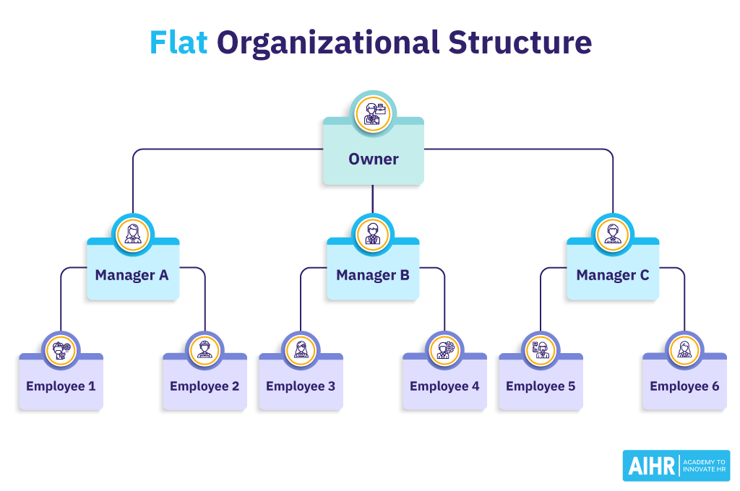

WHO ARE THE END USERS?

Slide 7
OUR SOLUTION AND ITS VALUE PROPOSITION
Conditional Formating
Filtering
Formula
Pivot table
Graph

Slide 8
DATASET DESCRIPTION
Employee ID
Name
Gender
Department
Salary
Employee Type

Slide 9

THE "WOW" IN OUR SOLUTION
FORMULA
PERFORMANCE LEVEL
= IFS(Z8>=5, “VERY HIGH”, Z8>=4, “HIGH”,Z8>=3,”MED”,TRUE,” LOW”)
3/21/2024 Annual Review
9

Slide 10
MODELLING
*Data collection
*Features
*Data cleaning
*Data representation
*Performance level
10

Slide 11
FEMALE EMPLOYEE

Slide 12
MALE EMPLOYEE

Slide 13
RESULTS
13

Slide 14
CONCLUSION
In conclusion, the employee data analysis conducted using Excel provides valuable insights into workforce trends and performance. The use of Excel's data visualization tools, such as charts and pivot tables, has enabled a clear understanding of key metrics, including employee productivity, attendance patterns, and departmental performance. This analysis highlights significant areas for improvement, such as identifying departments with lower engagement or spotting trends in absenteeism. Leveraging these findings allows for informed decision-making and targeted interventions to enhance employee satisfaction and operational efficiency. Moving forward, regular updates and further analysis will help sustain improvements and adapt strategies as needed.

